Slide 1
Storage of Databases
Need data to be stored “permanently” for long period of time

Slide 2
Block
A block is the largest contiguous amount of disk space that can be allocated to a file and is therefore the largest amount of data that can be accessed in a single I/O operation.
Usually but (not necessarily) stores records of a single file
Of fixed length, based on physical characteristics of storage/computing device and operating system

Slide 3
Blocking Factor
The number of records that are stored in a block is called the “blocking factor”. Blocking factor is constant across blocks if record length is fixed, or variable otherwise.
If B is block size and R is record size, then blocking factor is:
bfr = ⎣B/R⎦
Since R may not exactly divide B, there could be some left-over space in each block equal to:
B – (bfr * R) bytes.

Slide 4
Records
A file is a sequence of records
Records could be either fixed-length or variable-length
Records comprise of a sequence of fields (column, attribute)

Slide 5
Spanned and Unspanned Records
When extra space in blocks are left unused, the record organization is said to be “unspanned”.
Record 1
Record 2
Record 3
Unused

Slide 6
Spanned and Unspanned Records
In “spanned” record storage, records can be split so that the “span” across blocks.
Record 1
Record 2
Record 3
p
Block m
Record 4 (part)
Record 4
(remaining)
Block p

Slide 7
Spanned and Unspanned Records
When record size is greater than block size (i.e. R > B), use of
“spanned” record storage is compulsory.

Slide 8
File Organizations
File organization refers to the way records are stored in terms of blocks and the way blocks are placed on the storage medium.
Types of organizations
  Unsorted
  Sorted
  Hashing

Slide 9
Unordered File Organization
Record 1
Block m
Record 2
Record 3
Block p
Record 4
Also called a “pile file”…

Slide 10
Pile Files
Simplest file organization
Records are inserted in the order of their arrival
Insertion: very easy

Slide 11
Record Deletion in Pile Files
Record 1
Record 2
Record 3
Record 1
Record 3
Deletion by fragmentation.
Inefficient in terms of space usage.

Slide 12
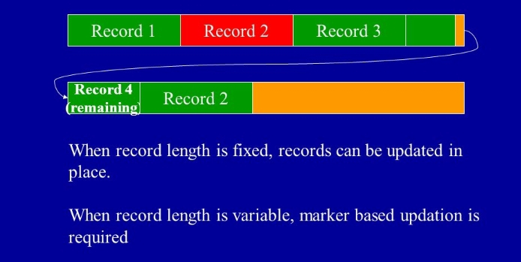
Record Updation in Pile Files

Slide 13
Sorted Files
File organization where records are sorted based on the value of some field called the ordering field
Ordering field should be a key field (unique for each record) and belong to an ordinal domain (where values can be compared)
Insertion and Deletion: both expensive
Updation may involve physical migration of record, if ordering field is modified
Searching: Binary search based on ordering field efficient

Slide 14
Sorted Files
Record 1
Record 3
Record 7
(Sorted)

Slide 15
Sorted Files
More efficient than pile-files for key-based searches
A better choice when database is mostly read-only and queries are mostly key-based retrievals

Slide 16
Hashing Techniques
Provide very fast access to records on certain search conditions
Search condition should be an equality condition on a “key” field
Uses a “hashing function” to map keys onto “buckets” hosting records

Slide 17
Internal (in-memory) Hashing
Used as an internal data structure to quickly access records that read into memory
Uses a static array of M buckets indexed from 0 to M-1

Slide 18
External Hashing
Block address
on the disk
Bucket
number
0
1
2
3
Hash(k)
4
5
6
7
8
9

Slide 19
Hashing
Uses two levels of indirection: hashing to buckets and searching within buckets
A bucket is a disk block or a set of contiguous blocks
Sequential search within buckets

Slide 20
Overflows
Occurs when a bucket receives more records than it can hold. Overflow management techniques:
Open addressing
  Use the next available bucket.
Chaining
  Pointers to extra buckets called overflow buckets.
Rehashing
  Use a second hashing function to see if it can hash without overflow.

Slide 21
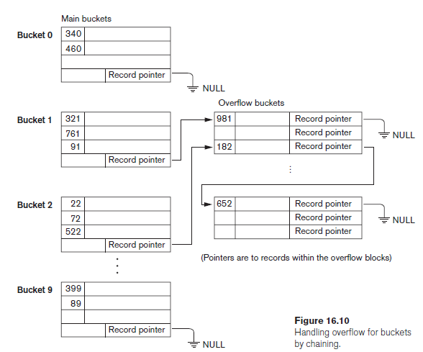
Handling Overflows with Chaining

Slide 22
Dynamic Hashing
Hashing where the number of buckets are fixed are called static hashing
Inefficient when data set is skewed. Few overflowing buckets and large number of nearly empty buckets
Number of buckets change dynamically in accordance with data requirements

Slide 23
Dynamic Hashing
No. of buckets may grow or shrink depending on additions and deletions
Overall strategy:
  start with a single bucket.
  Once full, split the bucket into two.
  Redistribute records between the two split buckets using some method ensuring near-uniform distribution

Slide 24
Dynamic Hashing
Bucket for all
Records
Assume keys to be made of binary strings…

Slide 25
Dynamic Hashing
Bucket for all
Records
Overflow!

Slide 26
Dynamic Hashing
Bucket for all
Records
Starting with 0
0
1
Bucket for all
Records
Starting with 1
Overflow!

Slide 27
Dynamic Hashing
Bucket for all
Records
Starting with 0
0
Bucket for all
Records
Starting with 10
1
0
1
Bucket for all
Records
Starting with 11
Underflow!

Slide 28
Dynamic Hashing
Bucket for all
Records
Starting with 0
0
1
Bucket for all
Records
Starting with 1

Slide 29
Summary
Storage Media and their characteristics
Records, Blocks and Files
Spanning and Unspanning records
Pile Files
Sorted Files
Hash Files
  Static versus dynamic hashing

